Slide 1
Multi-Switch Cooperative Sketch-based Monitoring
Wei-Te Lu 呂韋德
Advisor：Ching-Ju Lin 林靖茹

Slide 2


Network Measurement
Foundation for network applications
Network Measurement
Network Monitoring
Network Security
Analysis
Defense
Notes:
首先 在一個網路系統當中，網路量測扮演著一個十分重要的腳色。因為對於諸多網路應用以及管理來說，量測是他們不可或缺的基礎，像是網路狀態的監控或者是網路安全的防禦等等，都需要仰賴網路量測的結果，來做出相對應的分析或者是反應。
因此，為了讓這些application可以正常運作，量測的方法是十分重要且不可或缺的

Slide 3



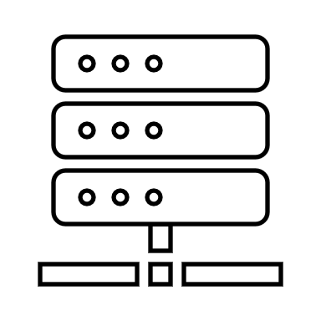


Existing Measurement Methods
Hash-based
4+1 | 52 | 31
5 | 20 | 3+1
14 | 2+1 | 9
74+1 | 3 | 6
h1(.)
h2(.)
F2
F1
h3(.)
h4(.)
sample
flow
flow
flow
Sample
Sketch
Network Measurement
Notes:
Partial/Sampling Only sample packets or flows, or collect detailed statistics based on a preconfigured list of conditionals.
Sketch-based Collects the information of every packet in a compact data structure, namely sketch, on network devices.

Slide 4
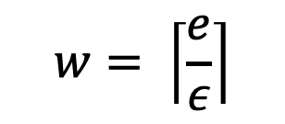
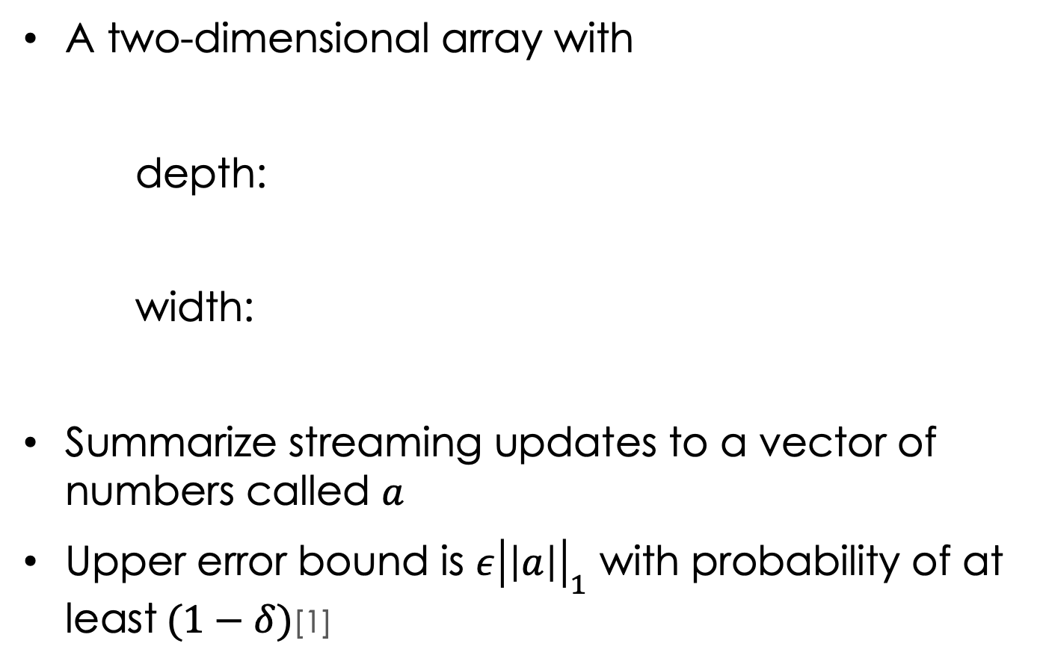
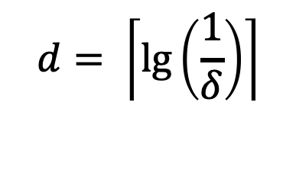
Sketch
A two-dimensional array with
depth:
width:
Summarize streaming updates to a vector of numbers called $a$
Upper error bound is $ε{\left|\left|a\right|\right|}_{1}$ with probability of at least$(1−δ)$[1]
w=3
$$d= \left\lceil \lg\left(\frac{1}{δ}\right)\right\rceil$$
h1(.)
0 | 0 | 0
0 | 0 | 0
0 | 0 | 0
0 | 0 | 0
h2(.)
d=4
$$w= \left\lceil \frac{e}{ε}\right\rceil$$
h3(.)
h4(.)
[1]G. Cormode and S. Muthukrishnan. An improved data stream summary: The count-min sketch and its applications. Journal of Algorithms, 55(1):58–75, 2005. Conference version in Proceedings of Latin American Theoretical Informatics (LATIN), 2004. Initial Technical Report published as DIMACS 2003-20, June 2003.

Slide 5
CM-Sketch
Insert
Query
0+1 | 0 | 0
0 | 0 | 0+1
0 | 0+1 | 0
0+1 | 0 | 0
0 | 0 | 0
0 | 0 | 0
0 | 0 | 0
0 | 0 | 0
h1(.)
h2(.)
Update the hashed bucket of each row
F2
F1
h3(.)
h4(.)
4 | 52 | 31
5 | 20 | 3
14 | 2 | 9
74 | 3 | 6
h1(.)
Flow ID (or 5-turple)
h2(.)
Packet count of flow (5-turple) = min(4,3,2,74) = 2
h3(.)
h4(.)

Slide 6
Sketch-Based Monitoring
Sketch based
Count-Min(CM) Sketch [1]
Count Sketch [2]
Univmon [3]
……
Hybrid Sketch Algorithm
Elastic Sketch [4]
HybridSketch [5]
……
[3-5]的first name 好像不見了
[2]M. Charikar, K. Chen, and M. FarachColton, “Finding frequent items in data streams,” in Proceedings of the International Colloquium on Automata, Languages and Programming, 2002.
[3] . Liu, A. Manousis, G. Vorsanger, V. Sekar, and V. Braverman, “One sketch to rule them all: Rethinking network flow monitoring with UnivMon,” in ACM SIGCOMM, 2016.
[4] . Yang, J. Jiang, P. Liu, Q. Huang, J. Gong, Y. Zhou, R. Miao, X. Li, and S. Uhlig, “Elastic sketch: Adaptive and fast networkwide measurements,” in ACM SIGCOMM, 2018. [5] . Zhao, M. Wen, M. Tang, Q. Huang, and C. Zhang, “HybridSketch: A memorycentric precise approach for flow measurement,” in IEEE ICC, 2020.

Slide 7
Sketch-Based Monitoring
Pros
Memory & Accuracy Tradeoff
Efficiency
Generality [Univmon, Sigcomm16]

Slide 8






Sketch-Based Monitoring
Cons
Collision
Overloaded per switch
F1
0 | 0 | 0 | 0 | 0 | 0
0 | 0 | 1 | 0 | 0 | 0
0 | 0 | 2 | 0 | 0 | 0
F2

Slide 9
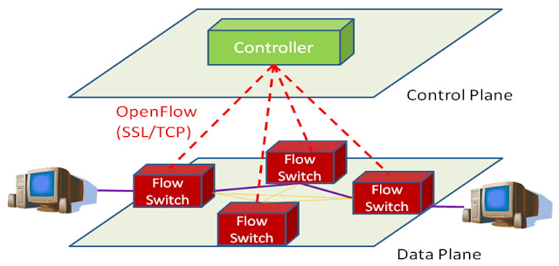

Sketch-Based Monitoring

Slide 10




Per-Switch Monitoring
F2
F1
F4
F3
☹ Eash switch is overloaded
☹ Many switches experience collisions

Slide 11
Cooperative Monitoring
F2
F1
F4
F3
☺ Offload monitoring load across switches
☺ Lower collision probability per switch

Slide 12



Traditional Way
這兩頁我在聽你講一下
圖我覺得太複雜
應該可以畫一個fat-free
然後畫兩個flow 走一樣的路
傳統的方法都在一個switch (or 每個switch)做sketch 然後說會碰撞就好
F4
F3
F2
F1
718 | 2041 | 262 | 593 | 362 | 903
F4
F3
F2
F1
S1
S3
705 | 2031 | 242 | 793 | 462 | 803
F4
F3
F2
F1
703 | 2231 | 442 | 393 | 862 | 603
F4
F3
F2
F1
S2
S4
765 | 1831 | 212 | 693 | 562 | 903

Slide 13

Ideal Way
F3
18 | 41 | 262 | 93 | 32 | 93
F1
S1
S3
70 | 87 | 12 | 79 | 42 | 83
F4
703 | 31 | 42 | 33 | 62 | 63
F2
S2
S4
75 | 31 | 22 | 23 | 562 | 63

Slide 14






Goal
Multi-Switch Cooperative Monitoring
Alleviate the degree of collisions
Reduce the worst ARE of all flows
Enhance efficiency of packet processing
Notes:
所有switch的合作，不需要每一個switch都去紀錄，而只要某幾個switch去紀錄就好。
有點像是分散式，合作式的sketch

Slide 15
Challenges
不太確定要怎麼講
想跟老師討論一下
→ 我寫了些草稿在note
How to assign flows to switches?
Distribute monitoring load across switches
Jointly consider routing to enhance offloading opportunities
How to provide heterogeneous monitoring resolutions for different flows?
More important flows, higher monitoring precision
Notes:
要設計一個合作是平台需要解決兩個問題
首先我們要先決定如何幫每個flow選定適當的switch來追蹤流量，確保每個flow都能被適當的追蹤
另外我們也需要綜合考慮flow的路由機制，讓所有switch能有更多的機會去平攤追蹤的負擔
另外因為每個flow的大小和重要性不同，我們也需要探討如何提供不同flow異質化的追蹤可靠度。理想上，我們希望越重要的flow能夠獲得更多switch的資源來達到較高的追蹤準確度

Slide 16
Outline
Overview
Design
Performance Evaluation
Conclusion

Slide 17
Problem Statement
Input
A set of switches and a set of flows
Task
Determine the routing path of flows
Determine the monitoring switches of each flow
Objective
Minimize the worst ARE of all flows

Slide 18
Flow Chart
End
No
Can its ARE be lowered?
Yes
Compute the ARE of flow
Flow selection
Switch selection
Choose the worst Flow
Choose the best path
Path selection

Slide 19


1. Path Selection
這頁不太確定你要講什麼
要是大家都選最短，會全部撞在一起
大家能選擇放的switch set都一樣
Naïve way: Shortest Path
Every flow use the same path
Set of switch
={s1,s2,s3}
S4
S5
S6
S7
Set of switch
={s1,s2,s3}
Set of switch
={s1,s2,s3}
S1
S2
S3

Slide 20
1. Path Selection
這頁不太確定你要講什麼
那要是我們把switch增加，變成整個網路裡面的switch你都能放
雖然set變大，但routing loading就會變重
Naïve way: Longest Path
Go through all switch

Slide 21
While true
f* $\get \arg\min_f ARE_f$
Find k-shortest paths of f*Identify the best switch * along k-shortest paths
Find the best switch s* along k-shortest paths
ARE \get ARE(f,s*\cup S_s*)
if ARE \le ARE_s*, ARE_s* \get ARE
otherwise break

Slide 22
Problem
Shortest path
Switch congestion → flow errors
Longest path
Higher offloading opportunity → Routing overhead

Slide 23
1. Path Selection
這頁不太確定你要講什麼 這幾頁文字的資訊量都太少了
這邊開始跑一次k-shortest path 給大家看
不知道會不會太長(?)
K-Shortest path
Yen's Algorithm
Use path loading and switch to choose best path
S4
S5
S6
S7
Set of best k-path
={[s1,s2,s3]}
First Path
={s1,s2,s3}
S1
S2
S3

Slide 24
K-Shortest path
這幾頁投影片我覺得圖都 看不太出最後使用的path 可能聽你錄影比較準
Set of best path
={[s1,s2,s3]}
S4
S5
S6
S7
First Path
={s1,s2,s3}
S1
S2
S3
Turn 1
={}

Slide 25
K-Shortest path
Set of best path
={[s1,s2,s3]}
S4
S5
S6
S7
First Path
={s1,s2,s3}
S1
S2
S3
Turn 1
={}
Turn 1
={[s1,s6,s7,s3]}

Slide 26
K-Shortest path
Set of best path
={[s1,s2,s3]}
S4
S5
S6
S7
First Path
={s1,s2,s3}
S1
S2
S3
Turn 1
={[s1,s6,s7,s3]}

Slide 27
K-Shortest path
Set of best k-path
={[s1,s2,s3],
[s1,s6,s7,s3]}
S4
S5
S6
S7
second Path
={s1,s6,s7,s3}
S1
S2
S3
Turn 2
={ }

Slide 28
K-Shortest path
Set of best k-path
={[s1,s2,s3],
[s1,s6,s7,s3]}
S4
S5
S6
S7
second Path
={s1,s6,s7,s3}
S1
S2
S3
Turn 2
={ }

Slide 29
K-Shortest path
Set of best k-path
={[s1,s2,s3],
[s1,s6,s7,s3]}
S4
S5
S6
S7
second Path
={s1,s6,s7,s3}
S1
S2
S3
Turn 2
={ }

Slide 30
1. Path Selection
這頁不太確定你要講什麼
Flow1
Flow2
Flow3
Set of switch
={s1,s2,s3}
S4
S5
S6
S7
Set of switch
={s1,s4,s5,s3}
Set of switch
={s1,s6,s7,s3}
S1
S2
S3

Slide 31
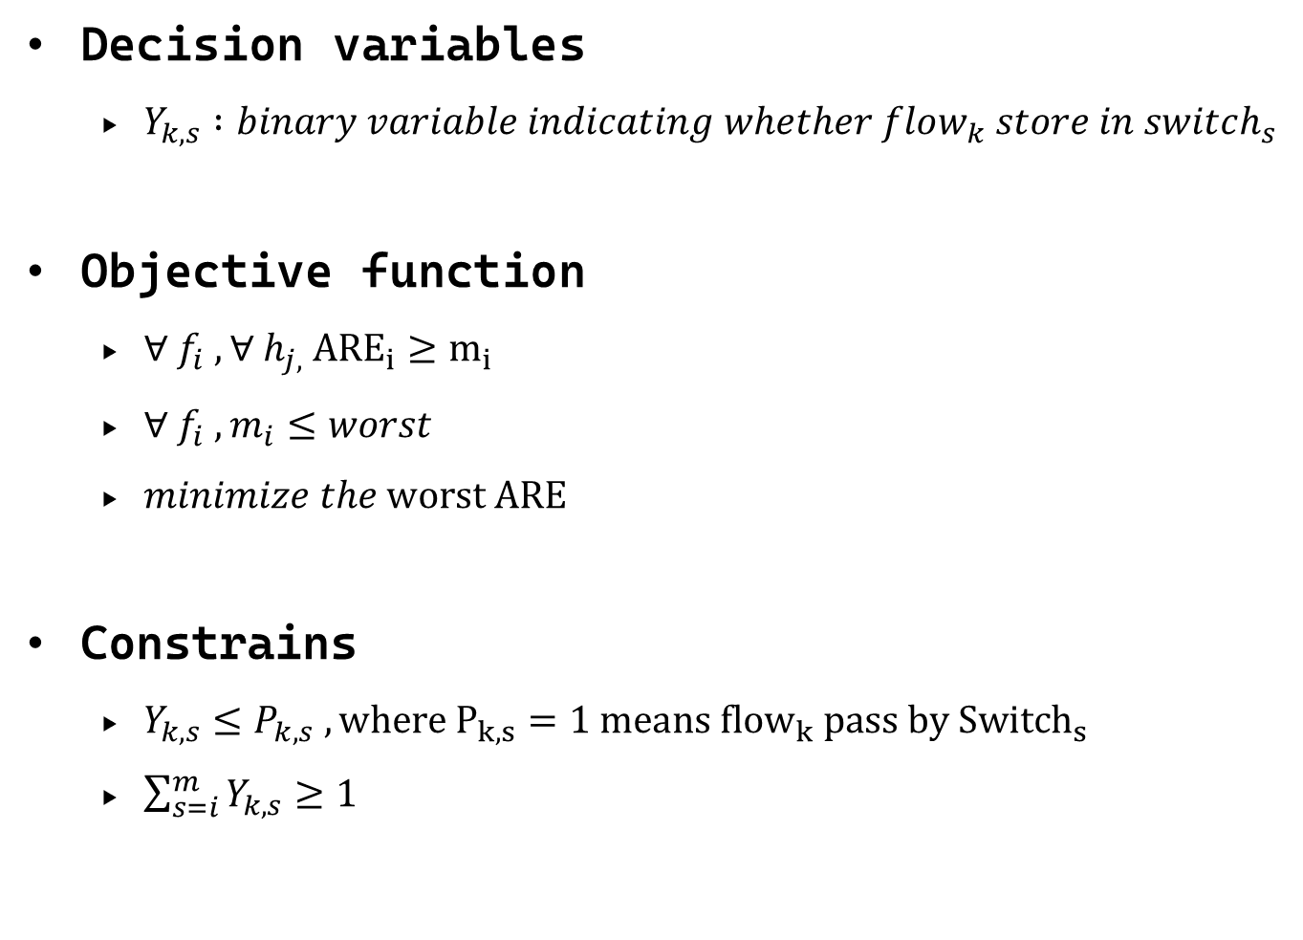
Problem Statement
Decision variables
$Y_{k,s} :binary variable indicating whether flow_{k} store in switch_{s}$
Objective function
$∀ f_{i} ,∀ h_{j,} {ARE}_{i}≥m_{i}$
$∀ f_{i} , m_{i}≤worst$
$minimize the worst ARE$
Constrains
$Y_{k,s}≤P_{k,s} ,where P_{k,s}=1 means {flow}_{k} pass by {Switch}_{s}$
$\sum_{s=i}^{m}{Y_{k,s}≥1}$

Slide 32
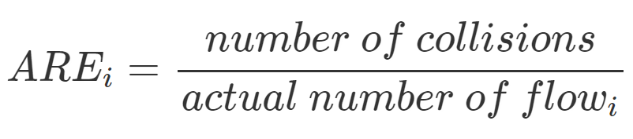
2. Switch Selection
公式每一頁的字要依樣大
用latex 打
Microsoft eq太醜!
Idea : Choose the best switch for a flow
Average Relative Error(ARE)
這一段我有在想，要不要加collision的推導在後面
讓大家知道我們的演算法 可以降低進去每一個sketch的封包量
進而達到降低error
因為我們之前的講法 好像是說這一個flow可以選擇的row變多(如果放在很多個switch)上的話
但其實傳統的也是 只是傳統的每一個sketch都要處理全部的flow
How to evaluate the performance of cross-switch ARE of a flow?

Slide 33


2. Switch Selection
How to evaluate the performance of cross-switch ARE of a flow?
h1(.)
4 | 52 | 31
5 | 20 | 3
14 | 2 | 9
74 | 3 | 6
h2(.)
h3(.)
h4(.)
192.168.1.1
ARE = min{4,5} = 4
h1(.)
45 | 23 | 14
55 | 80 | 43
18 | 29 | 37
74 | 5 | 18
h2(.)
h3(.)
h4(.)

Slide 34
Run
這頁不太確定你要講什麼 文字的資訊量都太少了
這邊是全部步驟跑一次

Slide 35

這頁不太確定你要講什麼 文字的資訊量都太少了

Slide 36
這頁不太確定你要講什麼 文字的資訊量都太少了

Slide 37

這頁不太確定你要講什麼 文字的資訊量都太少了

Slide 38
這頁不太確定你要講什麼 文字的資訊量都太少了
Can’t find better switch

Slide 39
這頁不太確定你要講什麼 文字的資訊量都太少了

Slide 40
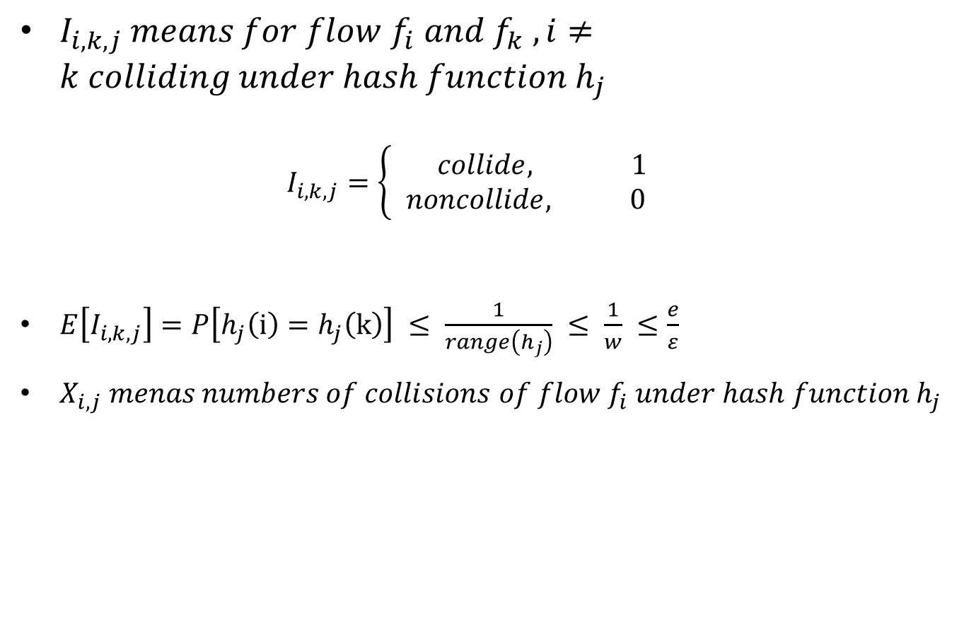
Number of collision
$I_{i,k,j} means for flow f_{i} and f_{k} ,i≠k colliding under hash function h_{j}$ $I_{i,k,j}=\left\{\begin{aligned} collide, 1 \\ &noncollide, 0\end{aligned}\right.$
$E\left[I_{i,k,j}\right]=P\left[h_{j}\left(i\right)=h_{j}\left(k\right)\right] ≤ \frac{1}{range\left(h_{j}\right)} ≤ \frac{1}{w} ≤\frac{e}{ε}$
$X_{i,j} menas numbers of collisions of flow f_{i} under hash function h_{j}$

Slide 41
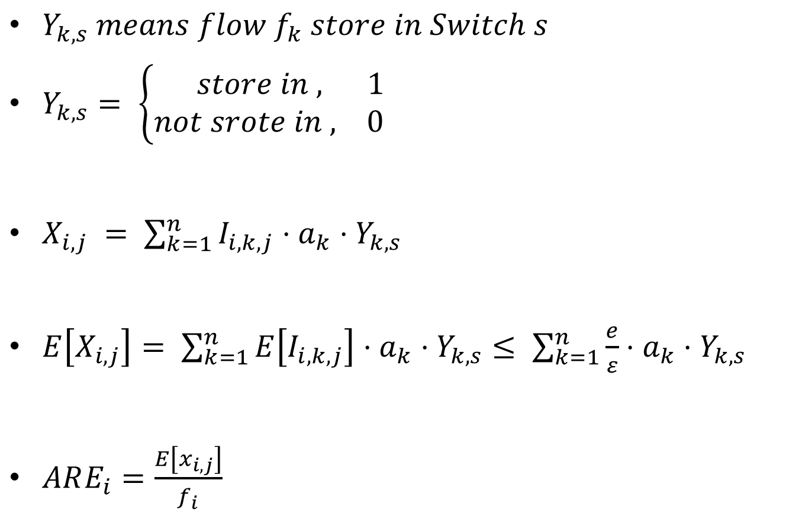
Number of collision
$Y_{k,s} means flow f_{k} store in Switch s$
$Y_{k,s}= \left\{\begin{aligned} store in , 1 \\ &not srote in , 0\end{aligned}\right.$
$X_{i,j} = \sum_{k=1}^{n}{I_{i,k,j}⋅a_{k}⋅Y_{k,s}}$
$E\left[X_{i,j}\right]= \sum_{k=1}^{n}{E\left[I_{i,k,j}\right]⋅a_{k}⋅Y_{k,s}}≤ \sum_{k=1}^{n}{\frac{e}{ε}⋅a_{k}⋅Y_{k,s}}$
$ARE_{i}=\frac{E\left[x_{i,j}\right]}{f_{i}}$

Slide 42
Outline
Overview
Algorithm
Performance Evaluation
Conclusion

Slide 43
Comparison Schemes and Metrics
Baseline schemes
CM-sketch : Original CM sketch
Shortest-Best-one : Store in one switch that on the path using Dijkstra
All-Best-one : Store in one switch that is best in the topology
Performance metrics
Topology
Memory usage
Traffic

Slide 44
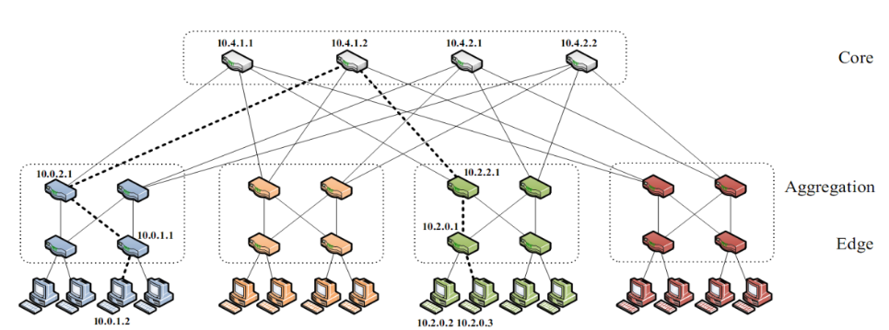


Topology
K-Ary Fat Tree
K = 6, K = 4
K = 4-1 , k = 4-2 , k = 4-3

Slide 45
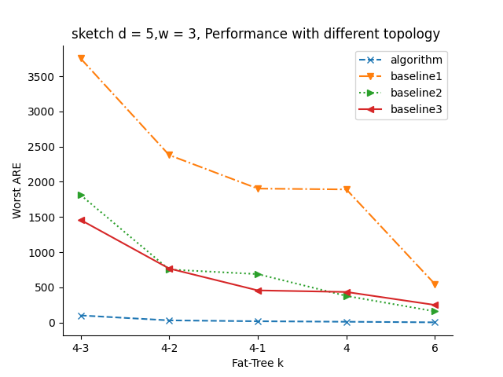
Worst ARE with Different Topology

Slide 46
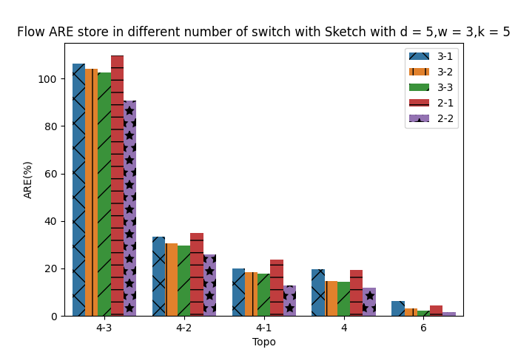
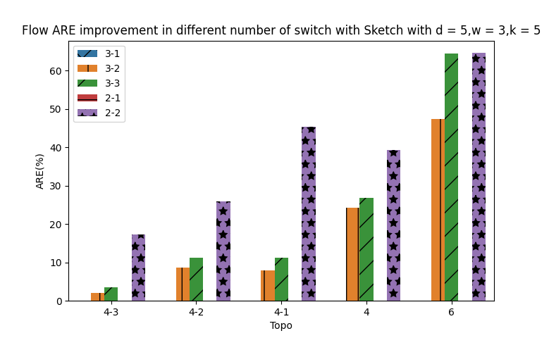

Slide 47
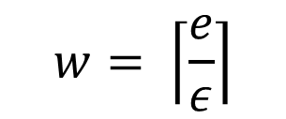
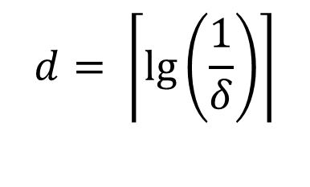
Memory Usage
D = 5(95%), w = 3(0.9), w = 6(0.45), w = 9(0.3)
D = 6, w = 9
$$d= \left\lceil \lg\left(\frac{1}{δ}\right)\right\rceil$$
$$w= \left\lceil \frac{e}{ε}\right\rceil$$

Slide 48
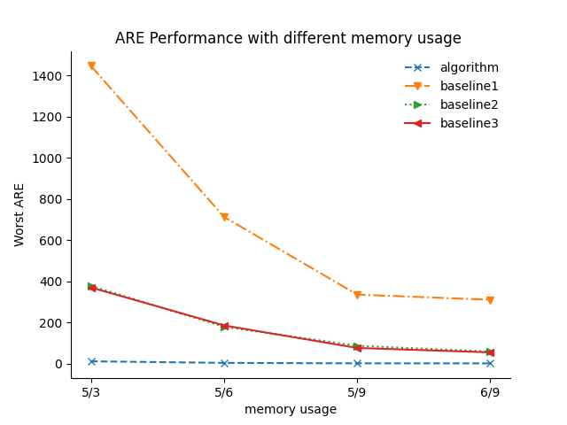
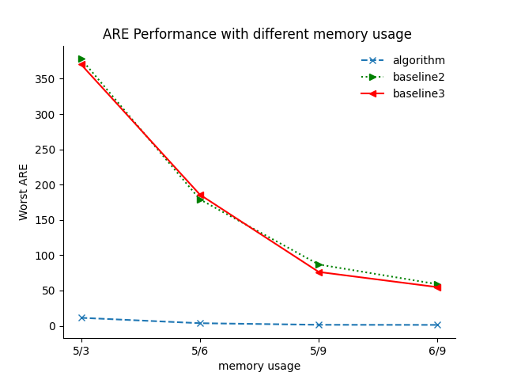
Worst ARE with Different Memory

Slide 49
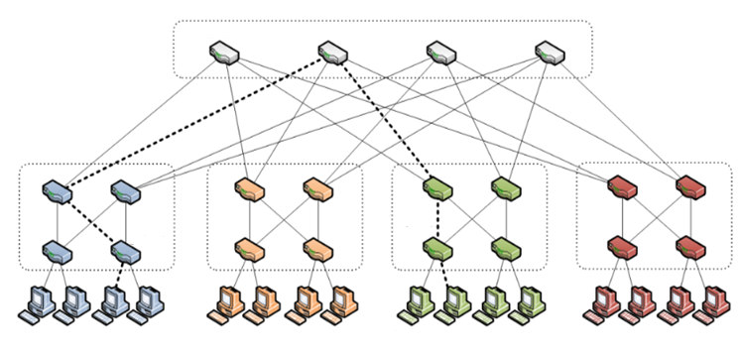
Traffic
Change the location of Src and Dst

Slide 50
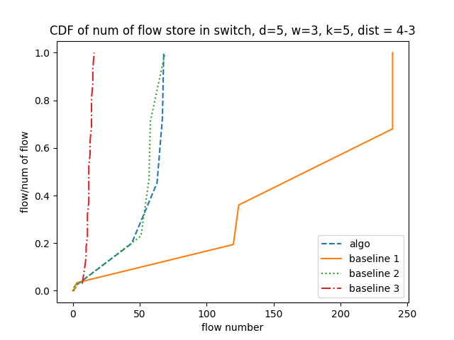
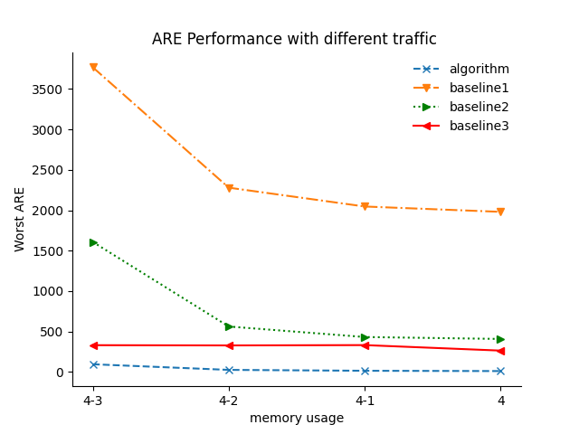
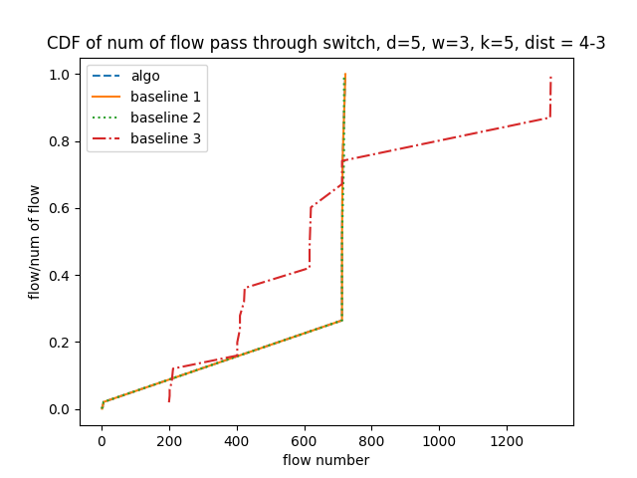

Slide 51
Outline
Overview
Algorithm
Performance Evaluation
Conclusion

Slide 52
Conclusion
Algorithm : A distributed system of Sketch based algorithm
Improve the situation of collision
Improve the worst ARE of all Flows
Enhance efficiency of switch process packets

